Slide 1
ITSC 307: PCI Compliance and Encryption
Module 1: Hash and Encryption Algorithms

Slide 2
Definitions
Encryption
The process of encoding a message or information in such a way that only authorized parties can read it.
Encryption (n.d.)
Cipher
An algorithm for performing encryption or decryption—a series of well-defined steps that can be followed as a procedure.
Cipher (n.d.)

Slide 3
Introduction
Decrypt the following message:
P NKDKUY DI KDZB NPQBN IDIB
Notes:
Give a minute or two to try and complete. We will circle back to it at the end of the module using cryptanalysis techniques.

Slide 4
Purpose
In addition to providing security through confidentiality, we also want to ensure the following:
Authentication
It should be possible to verify the origin of a message
Integrity
It should be possible to verify that a message has not bee altered during transit to the receiver
Nonrepudation
A sender should not be able to falsely deny that a message was sent

Slide 5
Encryption
For any message that you want to encrypt, use the following notation:
M -> plaintext message to be encrypted
C -> ciphertext used to obscure the message
E -> function used to convert M to encoded ciphertext C (encode)
D -> function used to convert C back to plaintext M (decode)
To encrypt a message use:
C = E(M)
To decrypt a message use:
M = D(C) or M = D(E(M))

Slide 6
Discussion Question
Is bad encryption worse than no encryption?
Notes:
Bad encryption can create a false sense of security for users.
Would you operate the same if you assumed that an eavesdropper would be able to understand your communications?

Slide 7
Encryption
Two general approaches to apply encryption:
Security through obscurity
Using a private process or algorithm (often called a restricted algorithm) to secure data
Open algorithm
Using a publicly available process or algorithm that relies on a randomly generated key or keys to provide security

Slide 8
Symmetric Encryption (1 of 2)
Uses the same key for both the sender and receiver
Encryption:
C = E{K₁}(M)
Decryption:
M = D{K₁}(C) where K₁ is a private key

Slide 9
Symmetric Encryption (2 of 2)
A private key needs to be exchanged before Alice and Bob can send messages.
Alice encrypts a message using the secret key.
Alice sends the message to Bob.
Bob receives the message and uses the same key to decrypt the ciphertext into plaintext.
If messages are captured during transit, they can’t be decrypted without the secret key.

Slide 10
Asymmetric Encryption (Public Key)
Designed so that the encryption key is different from the decryption key.
C = E{K_{Public}}(M)
M = D{K_{Private}}(C)
Example: Diffie-Hellman (1975)

Slide 11
Issues (1 of 2)
When trying to break ciphertexts, look at the following properties:
Entropy
Number of bits of information
E.g., Male or female
Rate of language
Information gained with each letter
Letter patterns and frequency
Unicity distance
Amount of data needed to validate a guess

Slide 12
Issues (2 of 2)
Decrypt the following message:
P NKDKUY DI KDZB NPQBN IDIB
Clues:
How many words in English have 1 or 2 letters?
Use frequency analysis to predict solutions
Answer:
A STITCH IN TIME SAVES NINE
Notes:
1 and 2 letter words:
A, I, K (slang), o (old English)
At, an, am, as, be, ba, in, on
Frequency analysis (from table):
e 12 i 7
t 9 s 6
a 8 h 6
O 7 r 6
N 7 d 4

Slide 13
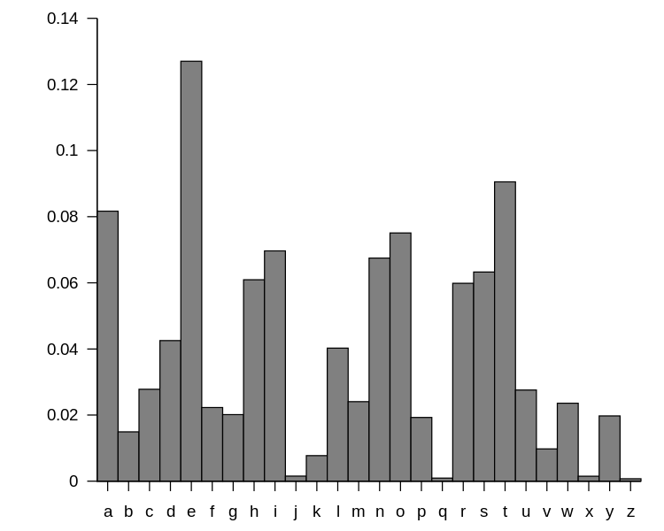
Frequency Analysis
Figure 1 shows the standard distribution of letters in English words.
How could an attacker employ this information to break encryption?
Figure 1: English Letter Distribution
© 2010, Nandhp, https://commons.wikimedia.org/wiki/ File:English_letter_frequency_(alphabetic).svg (Public Domain)
Notes:
Using the image above you can see that the most commonly used letters are E, T, and A. Are there way that we can exploit this cipher?

Slide 14
Approaches to Cracking
Ciphertext only
Hard to discover algorithm and keys used
Known plaintext
Easy to predict (e.g., header info, sync information)
WEP attacks
Chosen plaintext
Insert a known message and use ciphertext to determine
Adaptive chosen plaintext
Chosen key
Chosen ciphertext
Rubber hose cryptanalysis

Slide 15
Combating Cryptanalysis
Entropy is a quantity that describes how difficult a given ciphertext is to decrypt. There are two major factors that improve entropy:
Confusion
Each bit of the ciphertext should depend on several parts of the key.
Diffusion
If a single bit of the plaintext or ciphertext is changed, then at least half of the bits in the ciphertext or plaintext should also change.

Slide 16
One-Way Functions (1 of 2)
Also known as hash functions
Takes an input of any length and returns an output of fixed length
Typically used as digital signatures
Mathematically hard to reverse
Notes:
Examples of common hash functions include MD5, SHA1, and SHA2

Slide 17
One-Way Functions (2 of 2)
Example:
7919 is a prime number, x
7829 is the message, y
F(y) = x * y
= 7919 * 7829
= 61997851
Knowing only 61997851, how do you find y?
Notes:
Examples of common hash functions include MD5, SHA1, and SHA2

Slide 18
Hash Collisions
Because the one-way function returns a fixed value, other input values could produce the same output.
If an attacker finds a collision, they can use this value to appear as a legitimate message.
The goal of a good one-way function is to provide “collision resistance.”

Slide 19
Hash Collision Example
Malory prepares two contracts (1st is good for Alice, 2nd is not).
Using invisible characters (space-backspace-space) he creates two identical hash values for the documents. Since the combination could go almost anywhere in the document it is a brute-force technique.
Mallory sends Alice the “good” document, which she signs and returns.
Mallory substitutes the “bad” document for the good and takes Alice to court.

Slide 20
Summary (1 of 2)
Symmetric encryption uses the same key or keys for both the sender and receiver.
Asymmetric encryption uses a combination of public and private keys.
One-way functions produce an output of a fixed size from an input of any size.
Shannon’s information theory states that diffusion is achieved by using multiple parts of a key to create each bit in a ciphertext.
Shannon’s information theory states that confusion is achieved when changing a single bit in either the ciphertext or plaintext affects at least half or more of the output bits.

Slide 21
Summary (2 of 2)
Frequency analysis can be used to help break simple encryption.
One way functions return a fixed length output for any sized input.
Collisions occur when two input values return the same output from a hash function.

Slide 22
References
Cipher (n.d.) Retrieved Sep. 14, 2017 from Wikipedia: https://en.wikipedia.org/wiki/Cipher
Ecryption (n.d.) Retrieved Sep. 14, 2017 from Wikipedia: https://en.wikipedia.org/wiki/Encryption

Slide 23
© 2017, Southern Alberta Institute of Technology. All rights reserved.
This publication and materials herein are protected by applicable intellectual property laws. Unauthorized reproduction and distribution of this publication in whole or part is prohibited.
For more information, contact:
Director, Centre for Instructional Technology and Development
Southern Alberta Institute of Technology
1301 16 Ave. N.W., Calgary, AB T2M 0L4

Slide 24
ITSC 307: PCI Compliance and Encryption
Module 2: Analyzing Hash Algorithms

Slide 25
Topics
Definitions
Design requirements
MD5 algorithm
Hash collisions
Modern hashing algorithms
Summary
Resources
References

Slide 26
Definitions
Hash Function
A hash function is a process that can be used to convert an input message of arbitrary size to an output of a fixed size.
The values returned by a hash function are called hash values, hashcodes, digests or simply hashes.
Hash function (n.d.)

Slide 27
Definitions
One-Way Hash Function
A mathematical process that takes any input and produces an output, such that working from the output to the original input is impossible or impractical.
The output of most one-way functions are typically used for digital signatures as well as fingerprints for file verification.

Slide 28
Design Requirements
One-way hash functions are designed to meet five criteria:
Deterministic
Non-invertible
Quick to compute
Use the Avalanche Effect
Should avoid or eliminate collisions
Notes:
Design requirements
Deterministic – The same input should always produce the same output regardless of when it is computed
Non-invertible – It should be impossible or at least impractical (computationally complex and difficult) to be able to discern the original input given only the message digest
Quick to compute
Avalanche Effect – Needs to be designed so that even a small change of the input data should result in at least a 50% difference in the output data
Collisions – Because we are taking input of any size and confining the output to a specific size, there may be two or more input values that would produce the same output string.

Slide 29
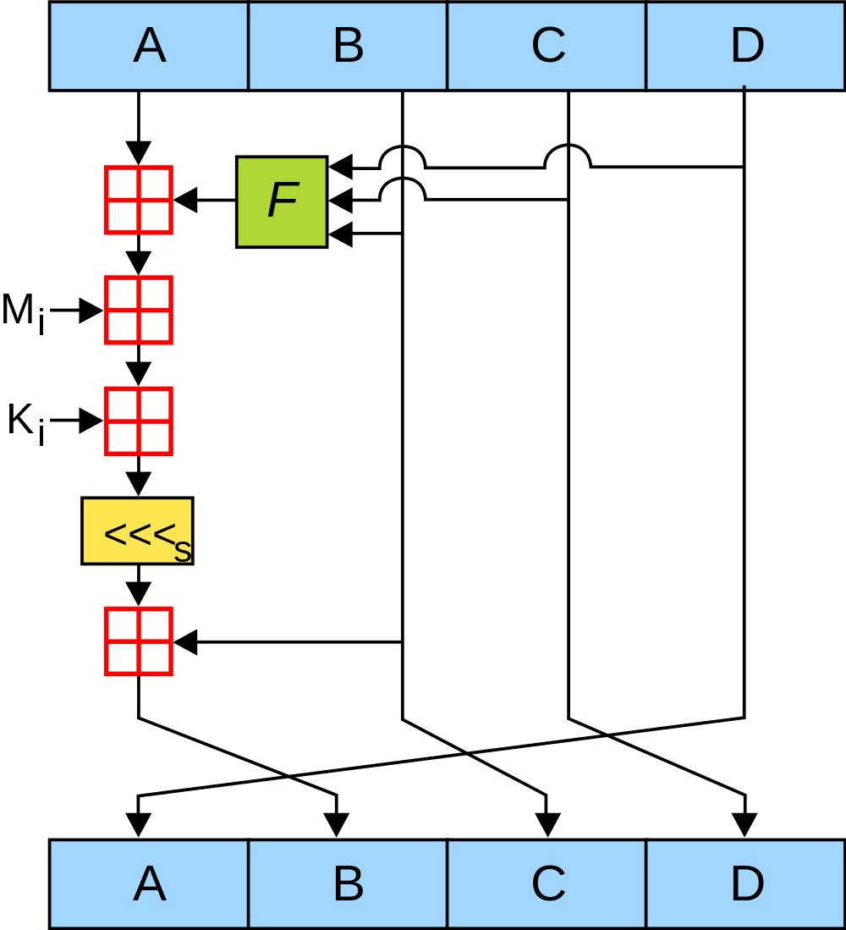
MD5 Algorithm History
Produces a message digest of 128-bits (16-byte Hex value)
1992: Created (RFC 1321)
2004: Flaws discovered
2007: Cracked
2008: Exploit released
2010: U.S. government moves to SHA-2
Figure 1: MD5 Process Diagram
© 2007, Surachit, https://commons.wikimedia.org/wiki/File:MD5.svg (CC BY-SA 3.0)
Notes:
The red boxes represent a modulus 32 addition operation with both inputs

Slide 30
MD5 Algorithm
Message is passed through the algorithm in blocks of 32 bits from the M_{i} until the entire message has been processed
K_{i} is the keystream used for a given round
F represents a non-linear function that changes over the 64 rounds used by the algorithm
Figure 1: MD5 Process Diagram
© 2007, Surachit, https://commons.wikimedia.org/wiki/File:MD5.svg (CC BY-SA 3.0)
Notes:
The red boxes represent a modulus 32 addition operation with both inputs

Slide 31
MD5 Algorithm
Because MD5 accepts an arbitrarily sized input, we may need to pad the input to a multiple of 512-bits (16 32-bit words)
Do this by adding a 1 to the end of the input stream, followed by zeroes up to the 512 – 64th bit
The last 64 bits are a representation of the length of the input (e.g., input modulus 2⁶⁴)
Message | 1 | 0 … 0 | Message % 64
M bits | 1 bit | N bits | 64 bits
Notes:
Entire length of the input must be a multiple of 512 bits. If not, padding must be applied to create a message of the required length.
To decrease the chance of a collision, a checksum of the message length is taken and appended to the padded message as the last 64 bits.

Slide 32
MD5 Algorithm
The keystream K_{i} is used to add a constant, unique value to each round of the hashing process.
K_{i} is calculated using integer part of the result for the formula
K_{i} = floor( abs( sin( i + 1) x 2³² ) )
Note: The i is in radians.
Notes:
Entire length of the input must be a multiple of 512 bits. If not, padding is applied to create a message of the required length.
To decrease the chance of a collision, a checksum of the message length is taken and appended to the padded message as the last 64 bits.

Slide 33
MD5 Algorithm
The non-linear function F is broken into four separate functions that are used for 16 consecutive rounds using the inputs B, C and D.
F₀₋₁₅(B, C, D) = (B & C) | (!B & D)
F₁₆₋₃₁(B, C, D) = (B & D) | (C & !D)
F₃₂₋₄₇(B, C, D) = B ⊕ C ⊕ D
F₄₈₋₆₃(B, C, D) = C ⊕ (X | !D)
Notes:
Operators used in Functions
& is AND
| is OR
! Is NOT
⊕ is XOR

Slide 34
MD5 Algorithm
The four variables A, B, C and D are initialized with constant values to start the process. This is commonly referred to as an initialization vector.
Note: Values are stored in little endian.
A = 0x67452301 -> 0x01234567
B = 0xEFCDAB89 -> 0x89ABCDEF
C = 0x98BADCFE -> 0xFEDCBA98
D = 0x10325476 -> 0x76543210

Slide 35
MD5 Algorithm
Once the addition of F_{round#}(B,C,D) + A + M_{i} + K_{i} has been computed, then the whole 32-bit sequence is left rotated by a given amount for each round, as shown below.
S₀₋₁₅ = [ 7, 12, 17, 22 ]
S₁₆₋₃₁ = [ 5, 9, 14, 20 ]
S₃₂₋₄₇ = [ 4, 11, 16, 23 ]
S₄₈₋₆₃ = [ 6, 10, 15, 21 ]
Note: Values repeat four times in the same order to create all 16 elements.

Slide 36
MD5 Algorithm
After the left shift, the input B is added to the result. This leaves us with the final swap of all four positions. The final result of a single round is shown below, where i is the round number.
A_{i + 1} = D
B_{i + 1} = B + ( F_{i}(B,C,D) + M_{i} + K_{i} + S_{i})
C_{i + 1} = B
D_{i + 1} = C

Slide 37
MD5 Algorithm
Review the process diagram.
Where does the output from the MD5 hash appear?
How many rounds would it take to compute the MD5 of a 637-bit message?
Figure 1: MD5 Process Diagram
© 2007, Surachit, https://commons.wikimedia.org/wiki/File:MD5.svg (CC BY-SA 3.0)
Notes:
The output from the MD5 hash is the concatenation of the final A + B + C + D in the bottom of the process diagram.

Slide 38
Hash Collisions
A hash collision is defined as two messages having the same hash value.
E.g., Hash(M) = Hash(M’)
One of the design requirements of a one-way hash function was to prevent the possibility of two messages producing the same hash value.
Notes:
Assume that Malory writes 2 contracts, one good and one bad, and manipulates both contracts by adding spaces and other characters to produce the same hash value from both contracts.

Slide 39
Hash Collision Activity
Download collision.zip from Brightspace.
Using the File Checksum Integrity Verifier (fciv.exe), record the MD5 digest for both hello.exe and hello2.exe.
After recording the values, run both hello.exe and hello2.exe.

Slide 40
Hash Collision Discussion
Is there a way this collision could have been prevented? If so, how?
How could collisions be used by a malicious user?

Slide 41
Modern Hashing Algorithms
Once the MD5 algorithm was broken, a suitable replacement was needed.
The NIST (National Institute of Standards and Technology) and the NSA (National Security Agency) designed the Secure Hashing Algorithm (SHA).
This hashing function produces a 160-bit output and is quite similar to MD5 in function.

Slide 42
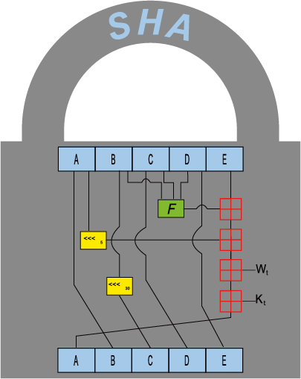
Modern Hashing Algorithms
This is the process diagram for SHA-1 and SHA-2.
Notice how it adds a 5th block, E, to achieve the 160-bit output.
Other changes include
use of different functions for F
80 rounds, rather than 64 used in MD5
Figure 1: SHA Process Diagram
Adapted from: Martens, U., 2017, https://commons.wikimedia.org/wiki/File:Sha-family.svg (CC BY-SA 4.0)

Slide 43
Modern Hashing Algorithms
There are many variants of SHA
Most common are SHA-1 and SHA-2
Primary differences between them are block size used for the message input and final digest size

Slide 44
Summary
Hash functions are used primarily for digital certificates and to create fingerprints used for file verification.
They are created with five main requirements:
Deterministic
Non-invertible
Quick to compute
Use the Avalanche Effect
Should avoid or eliminate collisions
The Message Digest Version 5 (MD5) algorithm takes an input of any size and produces a digest of 128-bits.

Slide 45
Summary
The MD5 message is padded to a multiple of 512 bits.
Four unique, non-linear functions are used during each round of the hashing process.
Hash collisions occur when two messages produce the same message digest.
Collisions can be prevented by increasing the size of the one-way function output or by using multiple hashing functions to verify the integrity of a file.
SHA-2 replaced MD5 once exploits were found.
SHA-1 is also considered broken.

Slide 46
Resources
Hashing Algorithms and Security - Computerphile (https://www.youtube.com/watch?v=b4b8ktEV4Bg)
MD5 Collisions, Visualized
(http://www.links.org/?p=6)
MD5 Collision Demo (http://www.mscs.dal.ca/~selinger/md5collision/)

Slide 47
References
Hash function (n.d.) Retrieved Sep. 14, 2017 from Wikipedia: https://en.wikipedia.org/wiki/Hash_function

Slide 48
© 2017, Southern Alberta Institute of Technology. All rights reserved.
This publication and materials herein are protected by applicable intellectual property laws. Unauthorized reproduction and distribution of this publication in whole or part is prohibited.
For more information, contact:
Director, Centre for Instructional Technology and Development
Southern Alberta Institute of Technology
1301 16 Ave. N.W., Calgary, AB T2M 0L4

Slide 49
ITSC 307: PCI Compliance and Encryption
Module 3: Encryption Algorithms

Slide 50
Topics
Definitions
Data Encryption Standard (DES)
Cryptanalysis
Public Key vs. Shared Secret
Advanced Encryption Standard (AES)

Slide 51
Definitions
Block Cipher
The message text is converted into cipher text in groups of characters or symbols.
Stream Cipher
The message text is converted into cipher text in single characters or symbols.

Slide 52
Data Encryption Standard (DES)
Adopted in 1975
Initial request came from the US government for digital information security
IBM, with assistance from the NSA, developed the accepted algorithm
By 1999, Triple DES (algorithm applied 3 consecutive times with up to three unique keys) was required for non-classified data
In Nov. 2008, DES algorithm could be brute forced in under 24 hours

Slide 53
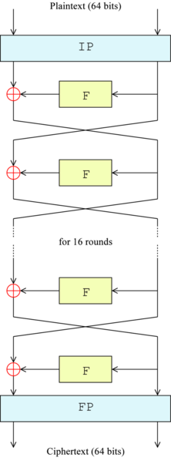
Data Encryption Standard (DES)
64-bit, block-based cipher (same number of input and output bits)
Plaintext split into two halves and processed in parallel
Consists of 16 rounds, similar to MD5, where a non-linear function is applied to one half, and then XOR-ed with the other half of the plaintext
After the XOR, both halves swap position
Encryption and decryption use the same key
Figure 1: Ciphertext (64 bits)
© 2005, Matt Crypto, https://en.wikipedia.org/wiki/File:DES-main-network.png (Public Domain)

Slide 54
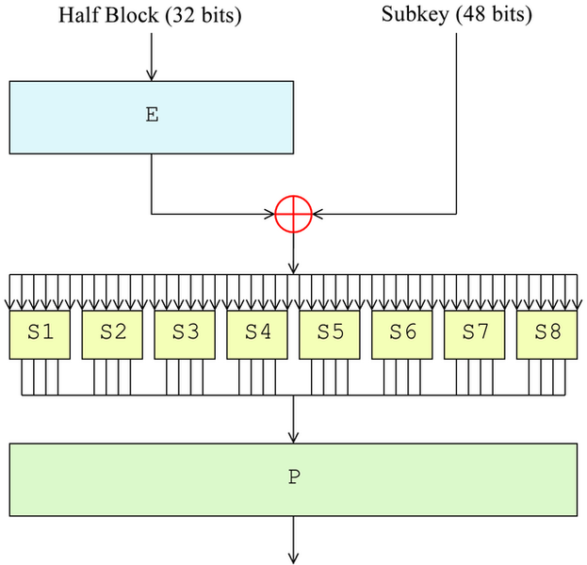
DES Feistel Function
Four primary components:
Expansion
Key Mixing
Substitution
Permutation
Figure 2: DES Feistel Function
© 2005, Matt Crypto, https://en.wikipedia.org/wiki/File:DES-f-function.png (Public Domain)
Notes:
1. Expansion: Each 32-bit half is expanded to 48 bits but duplicating half of the bits
2. Keymixing: The result is combined with a subkey using an XOR operation. Each subkey varies from round to round based on a key schedule outlined later
3. Subsitution: The 48-bit result of the keymixing is then split into 8 6-bit segments and each is given to a specific S-box
4. Permutation: The 32 outputs from the S-boxes are rearranged so that an even distribution from each S-box are use to create the new 32-bit output sequence

Slide 55
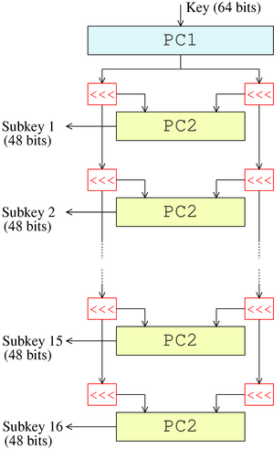
DES Key Schedule
56-bits of the input key are selected
Other bits used for error checking
Key is split into two halves and rotated an affixed amount each round
After rotation, halves are used as input for P-box and sent to the Fiestel function
Each bit of the 56-bit key is used for approximately 14 of the 16 rounds
Figure 3: DES Key Schedule
© 2007, Matt Crypto, https://en.wikipedia.org/wiki/File:DES-key-schedule.png (Public Domain)

Slide 56
Cryptanalysis
When trying to break ciphertexts, look at the following properties:
Entropy
Number of bits of unique information
E.g., Male or female, special characters, numbers
Rate of language
Information is gained with each letter of cipher text collected
Letter patterns and frequency
Unicity distance
Amount of data needed to validate a guess
Notes:
Entropy – When creating a key the goal is to achieve maximum entropy or randomness. This is typically done by adding a non-repeating sequence or additional types of characters to the selected secret string. Be careful when selecting things to change, as some of the common substitutions are also part of common attack dictionaries.
Rate of language – When given enough cipher text, it is possible to start to see patterns emerge. For instance, if you exchange greetings before getting to the heart of the message. After observing that same “Hello Bob” every single conversation, you can make assumptions based on common language patterns.

Slide 57
Frequency Analysis
Figure 4 shows the standard distribution of letters in English words.
How could an attacker employ this information to break encryption?
Figure 4: English Letter Distribution
© 2010, Nandhp, https://commons.wikimedia.org/wiki/ File:English_letter_frequency_(alphabetic).svg (Public Domain)
Notes:
Using the image above you can see that the most commonly used letters are E, T, and A. Are there way that we can exploit this cipher?

Slide 58
Approaches to Cracking
Ciphertext only
Hard to discover algorithm and keys used
Known plaintext
Easy to predict (e.g., header info, sync information)
WEP attacks
Chosen plaintext
Insert a known message and use ciphertext to determine
Adaptive chosen plaintext
Chosen key
Chosen ciphertext
Rubber hose cryptanalysis

Slide 59
Combating cryptanalysis
Entropy is a quantity that describes how difficult a given ciphertext is to decrypt. There are two major factors that improve entropy:
Confusion
Each bit of the ciphertext should depend on several parts of the key.
Diffusion
If a single bit of the plaintext or ciphertext is changed, then at least half of the bits in the ciphertext or plaintext should also change.

Slide 60
Public Key vs. Shared Key
There are two primary ways that keys are generated for encryption algorithms:
Shared secret
Each party agrees on a key to be used and physically exchanges it without being overheard
Allows for greater security, but can be difficult to exchange
Public key
A key pair is generated and the sender retains a private key that is used to encrypt information
The sender requests the public key and uses the public key to read the message

Slide 61
Advanced Encryption Standard (AES) (1 of 4)
Also known as the Rijndael algorithm
Replaced DES as the preferred standard in 2001
Three main variants fall under the same family, differing only in the block size used (128, 192 and 256)
Approved by the NSA for securing even top secret information when used with 192- or 256-bit block sizes

Slide 62
Advanced Encryption Standard (AES) (2 of 4)
Designed based on a substitution-permutation network
Allows for fast implementation in both hardware and software
Unlike DES, Feistel network not used
Operates on a 4x4 matrix of bytes that are put through a varying number of rounds based on key length
10 rounds for 128-bit key
12 rounds for 192-bit key
14 rounds for 256-bit key

Slide 63
Advanced Encryption Standard (AES) (3 of 4)
Four main components of the algorithm:
Key expansion
Initial round
Rounds
Sub bytes
Shift rows
Mix columns
Add round key
Final round
Notes:
1. Key Expansion: Each round key is derived from the key schedule. AES requires separate 128/196/256-bit key blocks for each round plus one extra
2. Initial Round: each byte in the matrix is XOR-ed with a block of the round key
3. Rounds:
3.1 Sub Bytes: A substitution step where each byte is replaced with another according to a lookup table
3.2 Shift Rows: Rotation of the last three rows of the matrix are moved a certain number of steps
3.3 Mix Columns: Multiplication operation on each column of the matrix to combine the 4 bytes together
3.4 Add Round Key: See 2. Initial Round
4. Final Round: Same procedure as 3. Rounds, but without the final Add Round Key operation

Slide 64
Advanced Encryption Standard (AES) (4 of 4)
Because all steps in AES are based on permutation and substitution, the whole process can be retained in memory to improve the encryption time.
4 kB of memory is needed to hold the whole algorithm, but can also be done with a 1 kB block and some additional steps.
The most effective attacks against the algorithm are side-channel attacks.
These target the computer doing the actual encryption and look for memory leaks while implementing the standard.

Slide 65
© 2017, Southern Alberta Institute of Technology. All rights reserved.
This publication and materials herein are protected by applicable intellectual property laws. Unauthorized reproduction and distribution of this publication in whole or part is prohibited.
For more information, contact:
Director, Centre for Instructional Technology and Development
Southern Alberta Institute of Technology
1301 16 Ave. N.W., Calgary, AB T2M 0L4

Slide 66
ITSC 307: PCI Compliance and Encryption
Module 4: Digital Certificates

Slide 67
Topics
Definitions
Public Key vs. Private Key
Digital Certificates
PKI (Public Key Infrastructure)
RSA Algorithms
Summary

Slide 68
Definitions
Digital Certificate
Means of ensuring anonymous communication between two parties
Typically used for online storefronts, email and secure file transfers
Achieved by using public key encryption and typically some form of a Public Key Infrastructure (PKI).

Slide 69
Public Key vs. Private Key (1 of 3)
Symmetric encryption uses the same key for both the sender and receiver.
Encryption:
C = E{K₁}(M)
Decryption:
M = D{K₁}(C) where K₁ is private key
Notes:
Review private key encryption:
All methods looked at so far deal with private keys. MD5, DES, AES, SHA, etc.

Slide 70
Public Key vs. Private Key (2 of 3)
A private key needs to be exchanged before Alice and Bob can send messages.
Alice encrypts a message using the secret key.
Alice sends the message to Bob.
Bob receives the message and uses the same key to decrypt the ciphertext into plaintext.
If Alice needs to communicate with 3,000 people, how may key pairs will Alice have to generate?
Notes:
Because symmetric encryption requires the use of symmetric keys than a new set will need to be both established and transmitted to each sender/receiver pair.
This creates a lot of overhead for not only Alice but also every other sender and receiver pair. Imagine how many keys would need to be handled by a large corporation with millions of clients!

Slide 71
Public Key vs. Private Key (3 of 3)
Asymmetric encryption was designed so that the encryption key is different, but also mathematically linked, from the decryption key. This allows for each party to store only one key pair to communicate with any number of people.
C = E{K_{Public}}(M)
M = D{K_{Private}}(C)
Notes:
Because of this asymmetric relationship, Alice will only have to keep track of two keys. Her personal private key and a general public key.
The advantage is that Alice is able to post her public key online for anyone to use and there is no need to facilitate the transfer of the secret key between sender and receiver pairs.

Slide 72
Digital Certificates (1 of 5)
The primary purpose of a certificate is to allow for secure, authenticated communication between two parties.
One advantage of a digital certificate is that, because of the public-private key pair, only one set of keys is needed to communicate with anyone.
Another advantage is that additional information can be stored with the certificate.

Slide 73
Digital Certificates (2 of 5)
A digital certificate can be used to store many different fields of information, including:
Serial number
Subject
Issuer
Not before
Not after
Notes:
Serial Number: Used to uniquely identify the certificate within a CA's systems. Primarily used to track revocation information.
Subject: The entity a certificate belongs to: a device, an user, or a company.
Issuer: The entity that verified the information and signed the certificate.
Not Before: The earliest time and date on which the certificate is valid. Usually set to a few hours or days prior to the moment the certificate was issued, to avoid clock skew problems.
Not After: The time and date past which the certificate is no longer valid.

Slide 74
Digital Certificates (3 of 5)
Common fields, continued:
Key usage
Extended key usage
Public key
Signature algorithm
Signature
Notes:
Key Usage: The valid cryptographic uses of the certificate's public key. Common values include digital signature validation, key encipherment, and certificate signing.
Extended Key Usage: The applications in which the certificate may be used. Common values include TLS server authentication, email protection, and code signing.
Public Key: A public key belonging to the certificate subject.
Signature Algorithm: The algorithm used to sign the public key certificate.
Signature: A signature of the certificate body by the issuer's private key.

Slide 75
Digital Certificate (4 of 5)
Sending signed data
Data is hashed to produce a digest
Digest is encrypted using the certificate’s private key (often referred to as a signature)
Encrypted digest (signature) is appended to the original data and sent to the receiver.

Slide 76
Digital Certificates (5 of 5)
Validating signed data
Original data is hashed to produce a digest
Signature is decrypted using the sender’s public key
The two hashes are compared. If they match, the authenticity of the message is confirmed.

Slide 77
Public Key Infrastructure (1 of 5)
Public Key Infrastructure (PKI) is a set of guidelines needed to create, distribute, store, use and revoke digital certificates and manage public key encryption.
Used to facilitate the secure electronic transfer of information for a range of network activities (e.g., online shopping, banking, confidential email).
Required for activities where simple passwords are inadequate for identity verification and more rigorous proof is required to confirm the authenticity of the parties involved.

Slide 78
Public Key Infrastructure (2 of 5)
The five main components of PKI are:
Certificate Authority (CA)
Registration Authority (RA)
Central Directory
Certificate Management System
Certificate Policy
Notes:
Certificate Authority:
Stores, issues and signs digital certificates
Includes CA private key when storing the key pairs so that trust is established if the CA is trusted
Sometimes referred to as a Trusted Third Party (TTP) or Registration Authority (RA) when the CA is separated from both the sender and receiver pair.
Registration Authority:
Verifies the identity of the end user during requests for their certificate(s) to be stored
Can also be incorporated with the CA to provide a single node that grants both the CA and RA roles
Central Directory:
A secure way to store and index keys for faster access time
Because a CA may be housing thousands of keys, there needs to be some way to split the listing into smaller subgroups
Certificate Management System:
Used to manually allow the ability to revoke and extend the life of certificates. Typically this would be the administrative side of certificate management.
Certificate Policy:
Set of guidelines that govern what is required of a given certificate. How long will certificates be issued for? Will companies be allowed to issue or only computers? What types of use with be allowed? How long will the key need to be?

Slide 79
Public Key Infrastructure (3 of 5)
Because PKI relies on the CA or RA to be trusted by third parties, there are four main methods by which this trust can be established:
Certificate authorities
Web of trust
Simple public key infrastructure
Blockchain-based PKI
Notes:
Certificate Authority:
Includes CA private key when storing the key pairs so that trust is established if the CA is trusted
Sometimes referred to as a Trusted Third Party (TTP) or Registration Authority (RA) when the CA is separated from both the sender and receiver pair.
Web of Trust:
Uses self-signed certificates and third party ‘vouches’ to maintain trust.
Take for instance a partnership between two companies A and B.
A will generate a self-signed certificate and use that certificate for an internal Certificate Authority. When users or devices from company A want to communicate with users or devices at Company B there would be no means of authenticating the self signed certificate generated by company A.
In web of trust the self-signed certificate from company A would be passed to the Certificate Authority of company B and ‘vouched’ for by the Certificate Authority of company A. Because users and devices in company B trust the Certificate Authority of company B then A can now communicate with B.
This would also happen in reverse to allow for B to communicate with A.
Simple Public Key Infrastructure:
Created as a means to do away with the complexity of CAs and Web of Trust. SPKI does not create a mapping of users to certificates and relies solely on the keys to maintain trust rather than the user.
Blockchain-based PKI:
Uses the same technology used in cryptocurrency to create a listing of key pairs and users that is both decentralized and distributable. Due to this fact the records contained in the data set are also unalterable.

Slide 80
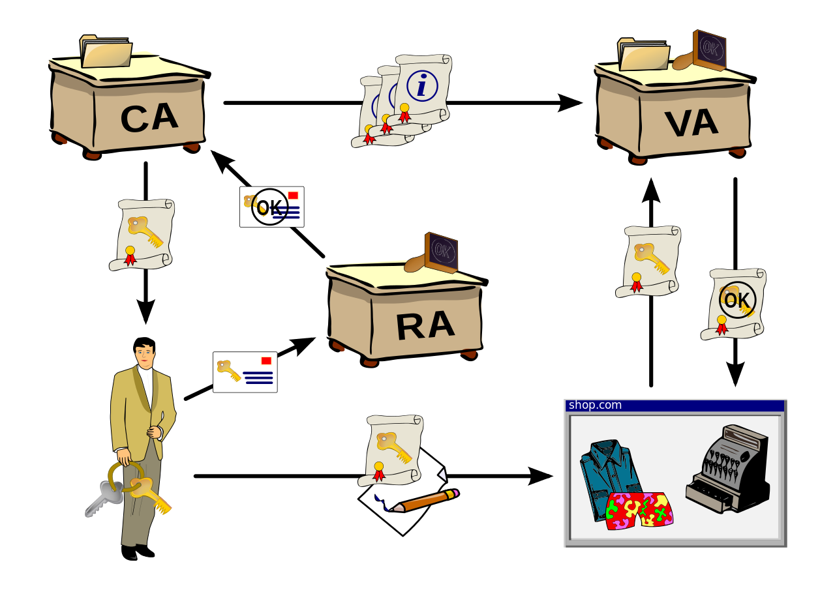
Public Key Infrastructure (4 of 5)
Figure 1: Public Key Infrastructure
© 2007, Chris 論, https://commons.wikimedia.org/wiki/File:Public-Key-Infrastructure.svg (CC BY-SA 3.0)
Notes:
Procedure for PKI:
Bob wants to purchase a new shirt online
Bob requests a new certificate to communicate with the retailer
The Registration Authority (RA) confirms Bob’s identity and passes the new key pair to the CA
A Certificate Authority (CA) issues Bob’s private key to Bob so that he can start his transaction
Bob encrypts his payment information with his private key and sends it to the retailer
The retailer needs to verify Bob’s identity using Bob’s public key. A request is sent to the Validation Authority (VA) used by the retailer
The VA looks at issuing CA and requests Bob’s public key. The public key is send to the VA and forwarded to the retailer
Once the public key is received, the payment information can be decrypted using Bob’s public key. The retailer then processes the transaction
Once the payment is confirmed, Bob receives his order confirmation

Slide 81
Public Key Infrastructure (5 of 5)
All the examples so far have had a single CA
Also possible to have multiple, lower-level CAs called Intermediary Certificate Authorities (ICA).
The Root CA signs the ICA’s certificate. As long as the Root CA is trusted, then the ICAs is trusted as well.

Slide 82
RSA Algorithm (1 of 2)
Created by Ron Rivest, Adi Shamir and Leonard Adleman in 1977
First public implementation of a public/private key pair system.
Uses the factorization and multiplication of prime numbers
Encryption happens quickly, but decryption is nearly impossible without the private key
This kind of function is commonly referred to as a trapdoor hash

Slide 83
RSA Algorithm (2 of 2)
Trapdoor hashes use a computer’s ability to multiply numbers quickly and factor numbers with great difficulty.
For example: 39 * 127 = 4953
Given only 4953, how long does it take to find the original factors?

Slide 84
Summary (1 of 2)
Digital Certificates are used to ensure secure and authenticated communication between two parties.
Certificates make use of a public-private key pair that is mathematically linked and is a form of asymmetric encryption.
Use of a public-private key pair reduces the need for numerous keys to be stored for each sender and receiver.
Certificates can store more than just the key pair (e.g., computer or hostname, time that the key is valid, who issues the certificate)

Slide 85
Summary (2 of 2)
PKI has 5 components: Certificate Authority, Registration Authority, Central Directory, Certificate Management System and Certificate Policies
PKI has 4 modes of trust: CAs, Web of Trust, Simple PKI (SPKI) and blockchain-based PKI
A Root Certificate Authority is the highest level of issuing certificates. Additional certificate requests can be created and are called Intermediary Certificate Authorities.
RSA is the primary algorithm used to create digital certificates. It is based on a trapdoor hash.

Slide 86
© 2017, Southern Alberta Institute of Technology. All rights reserved.
This publication and materials herein are protected by applicable intellectual property laws. Unauthorized reproduction and distribution of this publication in whole or part is prohibited.
For more information, contact:
Director, Centre for Instructional Technology and Development
Southern Alberta Institute of Technology
1301 16 Ave. N.W., Calgary, AB T2M 0L4

Slide 87
ITSC 307: PCI Compliance and Encryption
Module 5: Authentication Protocols

Slide 88
Topics
Introduction
Diffie-Hellman
Kerberos
RADIUS
Circumventing authentication protocols
Summary

Slide 89
Introduction
Authentication protocols are used to verify the identity of connected network entities within both local and remote networks.
The choice of which protocol to implement determines what entities or devices are authenticated and at what network layer the authentication occurs.

Slide 90
Diffie-Hellman (1 of 3)
First published by Whitfield Diffie and Martin Hellman in 1976
The first publicly available private key exchange
Prevents third parties from intercepting secret keys being distributed to sender and receiver

Slide 91
Diffie-Hellman (2 of 3)
Public key cryptography - Diffie-Hellman Key Exchange (full version) (https://www.youtube.com/watch?v=YEBfamv-_do)

Slide 92
Diffie-Hellman (3 of 3)
It is possible to select practically any value for initial values.
When new values are chosen for each new message or person that either the sender or receiver communicates with, even if one conversation is decrypted all other communications are protected.
This property is called forward secrecy or perfect forward secrecy.
Note: Diffie-Hellman does not authenticate either the sending nor receiving parties.

Slide 93
Kerberos ( 1 of 3)
Developed by MIT in the 1980s to protect network services provided by the school
Uses tickets to authenticate entities communicating over a non-secure network securely
Relies on a trusted third party to provide the tickets and prevent both eavesdropping and replay attacks
Based on a client-server relationship with a third party for authentication
Implements DES internally to encrypt the messages sent between client and server

Slide 94
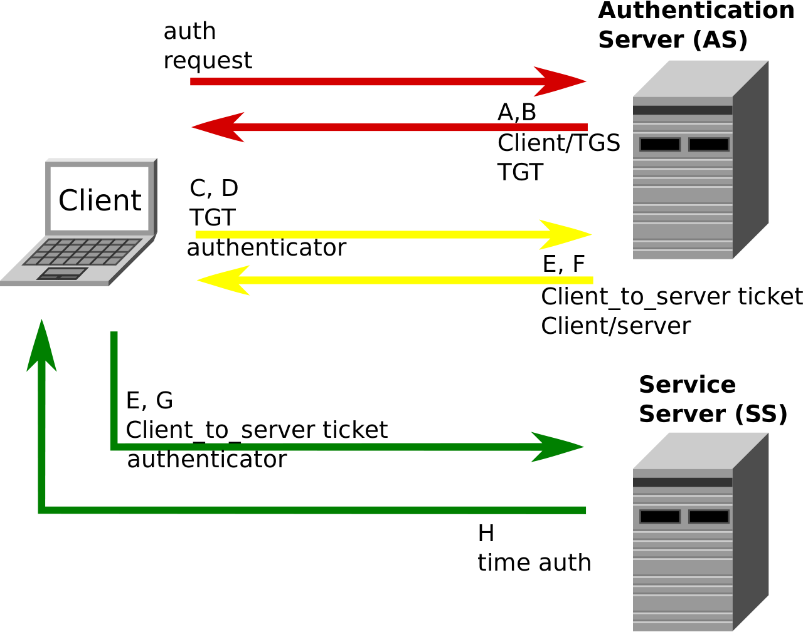
Kerberos (2 of 3)
Figure 1: Kerberos Diagram
© 2011, D. Sonck, https://en.wikipedia.org/wiki/File:Kerberos.svg (CC BY-SA 3.0)

Slide 95
Kerberos (3 of 3)
Kerberos keeps a database of clients and their secret keys
Users authenticate using their password and other network information (e.g., IP address, timestamp)
Because Kerberos knows everyone’s secret keys, it can create messages that convince one entity of another entity’s identity.
Sessions are used and destroyed by the two communicating parties to prevent replay attacks.

Slide 96
How Kerberos Works
Client A wants to communicate with Server B. Client A sends a request for a Ticket Granting Ticket (TGT) to the Kerberos authentication service (AS in the previous diagram), along with Client A’s password.
After Kerberos verifies Client A’s identity, a session key (the TGT), is created and issued to Client A. The TGT is encrypted with Client A’s private key.
Client A sends the TGT to the Ticket-Granting Service (TGS) to get a Server Ticket for Server B.
The TGS validates the information in the TGT with the authentication details provided by Client A and issues the Server Ticket to Client A.
Client A sends the Server Ticket to Server B.
Server B trusts Client A because Server B trusts the TGS.

Slide 97
Kerberos
Figure 1: Kerberos Diagram
© 2011, D. Sonck, https://en.wikipedia.org/wiki/File:Kerberos.svg (CC BY-SA 3.0)

Slide 98
RADIUS
Remote Authentication Dial-In Service (RADIUS) provides centralized authentication, authorization and accounting (AAA) management for network services with which users interact.
Developed in 1991 by Livingston Enterprises, Inc.
Runs in the Application layer of the OSI network model.
Primary method of securing IEEE 802.1x traffic.

Slide 99
How RADIUS Authentication Works
User sends request to Network Access Server (NAS), which includes the user credentials and requested service.
The NAS sends the request to the RADIUS server.
The RADIUS server verifies the information against its own user database to verify the users credentials
Typically one of the following: SQL, LDAP, Active Directory, Kerberos
The RADIUS server sends back one of three messages:
Access-Accept
Access-Reject
Access-Challenge

Slide 100
How RADIUS Authentication Works
Access-Accept
User granted access to whatever resources have been allowed for that particular account (e.g., allow HTTPS but deny FTP and VPN)
Access-Reject
User denied access to all requested network resources unconditionally
Typically occurs when proof of identity fails or the account has not been granted access to any network resources or services
Access-Challenge
Request for additional information, like two-factor authentication, is required for proof of identity
Sometimes used to prevent the NAS from seeing the access credentials of the client user

Slide 101
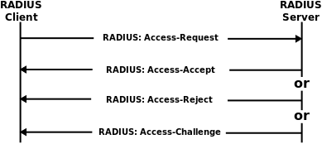
RADIUS Authentication
Figure 2: RADIUS Authentication
© 2011, Emilhem, https://commons.wikimedia.org/wiki/File:Drawing_RADIUS_1812.svg (CC BY-SA 3.0)

Slide 102
How RADIUS Accounting Works
When the NAS grants network access to the user, an Accounting Start is sent from the NAS to the RADIUS server.
Interim Update records may periodically be sent from the NAS to the RADIUS server. These records contain information of the connection duration as well as data usage.
Once the connection finishes, an Accounting Stop record is sent from the NAS to the RADIUS server.
This record contains the total duration of the connection, data usage and the reason for the connection to end
This information is typically used to bill dial-in customers
Can also be used for network statistics

Slide 103
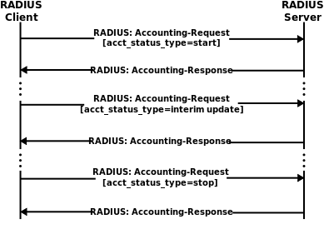
RADIUS Accounting
Figure 3: RADIUS Accounting
© 2011, Emilhem, https://commons.wikimedia.org/wiki/File:Drawing_RADIUS_1813.svg (CC BY-SA 3.0)

Slide 104
Circumventing Protocols
There are numerous ways to attempt to bypass authentication protocols. The best way to defend against attacks is to understand the basic way in which the attacks themselves are carried out.
Six common attack vectors are outlined below:
Basic authentication bypass
Changing fixed parameters
Session prediction
Obscuring restricted URLs
SQL injection
Man-in-the-middle

Slide 105
Basic Authentication Bypass
Technique assumes that verification occurs only at the network perimeter and, once authentication occurs, that all resources are available.
For example, a secure login page that validates credentials but the administration pages don’t check to see if login was successful
A malicious user can simply enter the URL to go directly to the administration page without the need to log in.

Slide 106
Changing Fixed Parameters
If authentication is stored in a detectable way, then it is possible to modify the request to spoof authentication.
For example, an internal user management page uses HTTPS with a string such as: https://mycorp.example.ca/?auth=0 to secure a restricted resource
A malicious user can spoof a successful login by modifying the requested URL to https://mycorp.example.ca/?auth=1, bypassing validation

Slide 107
Session Prediction
Previous examples can both be overcome by making use of a session ID or token for each resource request.
Session prediction attempts to determine what a session ID will look like and either creates a legitimate-looking session ID or hijacks an existing session ID.
For example, if a session ID is created using a combination of a username plus a timestamp, an attacker can determine this pattern and obtain a username through network sniffing, and a session ID would be easy to create or impersonate.

Slide 108
Obscuring Restricted URLs
Some applications use a list of restricted resources and force authentication of those specific service names.
For example, if ftp://server.mycorp.ca/ is a restricted resource, what happens if an attacker inserts an inert character into the requested sequence (e.g., ftp://server.mycorp.ca/?). Could be met without the need for authentication.
Not checking for variations on the original string can result in vulnerabilities.

Slide 109
SQL Injection
This attack can be used against any type of input that is directly passed on to another query of the system without validation.
For example, a web login page that uses a username and password field that queries against a database table. What is the result of entering the following username or password?
Password’ or ‘1’ = ‘1
If the query is something like (authorize user) WHERE Password=‘$password’, then the result becomes (authorize user) WHERE Password=‘Password’ or ‘1’ = ‘1’ results in an always true clause from the injected OR ‘1’=‘1’ statement.

Slide 110
Man-in-the-Middle
Uses the fact that the sender and receiver are not verified.
For example, Alice wants to send a message to Bob, but both Alice and Bob are unaware that they are being monitored by Malory. Malory intercepts Alice’s and Bob’s messages and then sends their responses back to both Alice and Bob so that they assume they are communicating directly with each other.
Malory now has access to the entire communication even if a key exchange protocol is used to secure the communication.

Slide 111
Summary (1 of 2)
Key exchange protocols are useful for protecting a secret key from being transported in plaintext across a network.
Key exchange allows for forward secrecy, sometimes called perfect forward secrecy to be achieved by changing the initial agreed upon values for each new communication.
Diffie-Hellman does not validate the sender or receiver.
Kerberos implements DES internally for security.
Kerberos uses third-party trust to identify entities to other entities.
The Ticket Granting Ticket consists of a session key and the identification details about the requesting entity.
The Ticket Granting Service validates the TGT and returns the Server Ticket to the requesting client.

Slide 112
Summary (2 of 2)
Kerberos service contains a copy of all entity’s private keys.
RADIUS is used primarily for 802.1x monitoring.
RADIUS provides Authentication, Accounting and Authorization for network traffic.
RADIUS uses the Application layer primarily.
When trying to prevent attacks, always be aware of how to circumvent current security.
Man-in-the-middle and replay attacks are the most common forms of authentication circumvention.

Slide 113
© 2017, Southern Alberta Institute of Technology. All rights reserved.
This publication and materials herein are protected by applicable intellectual property laws. Unauthorized reproduction and distribution of this publication in whole or part is prohibited.
For more information, contact:
Director, Centre for Instructional Technology and Development
Southern Alberta Institute of Technology
1301 16 Ave. N.W., Calgary, AB T2M 0L4

Slide 114
ITSC 307 PCI Compliance and Encryption
Module 6: PCI Fundamentals

Slide 115
Definitions
PCI
Payment Card Industry
DSS
Data Security Standard

Slide 116
PCI Compliance
How does this affect you as a security professional?
Notes:
Most companies that accept credit cards will look to you to provide guidance and direction.
The Payment Card Industry Data Security Standard (PCI DSS) is a widely accepted set of policies and procedures intended to optimize the security of credit, debit and cash card transactions and protect cardholders against misuse of their personal information. The PCI DSS was created jointly in 2004 by four major credit-card companies: Visa, MasterCard, Discover and American Express.
https://www.pcisecuritystandards.org/

Slide 117
Why Security Matters
The security of cardholder data affects everybody
Potential liabilities include:
Lost confidence, customers go to other merchants
Cost of reissuing new payment cards
Higher subsequent costs of compliance
Fines and penalties
Termination of ability to accept payment cards
Going out of business
(Why Security Matters, n.d.)
Notes:
From customers to merchants and financial institutions, the security of cardholder data affects everybody. Discover how securing cardholder data can help preserve customer trust, ensure compliance, and benefit organizations in the long term.
The breach or theft of cardholder data affects the entire payment card ecosystem. Customers suddenly lose trust in merchants or financial institutions, their credit can be negatively affected -- there is enormous personal fallout. Merchants and financial institutions lose credibility (and in turn, business), they are also subject to numerous financial liabilities.
A cautionary note: PCI compliance does not equal security. It is a point in time assessment of the security for a small portion of an organization. The PCI DSS can be used to enhance security throughout an organization by applying common security principals.
https://www.pcisecuritystandards.org/
Other Points:
Diminished sales
Fraud losses
Legal costs, settlements and judgments
Lost jobs (CISO, CIO, CEO and dependent professional positions)
Hackers want your cardholder data. By obtaining the Primary Account Number (PAN) and sensitive authentication data, a thief can impersonate the cardholder, use the card, and steal the cardholder’s identity.
https://www.pcisecuritystandards.org/

Slide 118
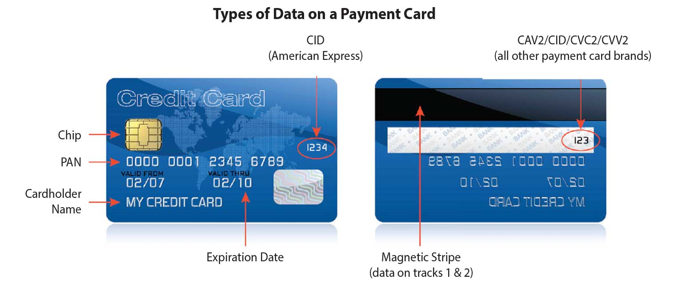
Types of Data on a Payment Card
Source: PCI Security Standards Council, 2017. Reproduced and used in accordance with the fair dealing provisions in section 29 of the Canadian Copyright Act for the purposes of education, research or private study. Further distribution may infringe copyright.
Notes:
The amount of data on a single credit card is surprising. Take a look at one and think about what would happen if the wrong people get this information.

Slide 119
Where Thieves Steal Data
Compromised card reader
Paper stored in a filing cabinet
Data in a payment system database
Hidden camera recording entry of authentication data
Secret tap into the business’s wireless or wired network
(Why Security Matters, n.d.)
Notes:
Sensitive cardholder data can be stolen from many places:
https://www.pcisecuritystandards.org/

Slide 120
What Needs to be Secure?
Card readers
Point of sale systems
Store networks and wireless access routers
Payment card data storage and transmission
Payment card data stored in paper-based records
Online payment applications and shopping carts
(Why Security Matters, n.d.)
Notes:
You secure cardholder data where it is captured at the point of sale and as it flows into the payment system. The best step you can take is to not store any cardholder data. T
Not storing cardholder data removes a lot of the risk and reduces the scope of a PCI compliance activity.
https://www.pcisecuritystandards.org/

Slide 121
Recent Breaches
TJX
Target
Heartland Payment Systems
Notes:
http://www.computerworld.com/article/2544306/security0/tjx-data-breach--at-45-6m-card-numbers--it-s-the-biggest-ever.html
TJX suffered the largest computer data breach in corporate history, affecting over 45 million credit and debit cards.
Bjorhus, J. (2014). “Clean Reviews Preceded Target’s Data Breach, and Others”. Retrieved August
15, 2015 from www.govtech.com website: http://www.govtech.com/security/Clean-Reviews-PrecededTargets-Data-Breach-and-Others.html
Target, breached in 2013, was certified PCI DSS compliant weeks before criminals installed malware on the retailer’s network.
Brenner, B. (2009). “Heartland CEO on Data Breach: QSAs Let Us Down”. Retrieved August 15,
2015 from www.csoonline.com website: http://www.csoonline.com/article/2124260/privacy/heartland-ceoon-data-breach--qsas-let-us-down.html
Heartland Payment Systems suffered a major breach even though assessors have been deeming this company compliant for six consecutive years.

Slide 122
Ten Common Myths of PCI DSS
Myth 1 – One vendor and product will make us compliant.
Myth 2 – Outsourcing card processing makes us compliant.
Myth 3 – PCI DSS compliance is an IT project.
Myth 4 – PCI DSS will make us secure.
Myth 5 – PCI DSS is unreasonable; it requires too much.
(Ten Common Myths, n.d.)
Notes:
1. Many vendors offer an array of software and services for PCI DSS compliance. No single vendor or
product, however, fully addresses all 12 requirements of PCI DSS. When marketing focuses on one
product’s capabilities to the exclusion of other PCI DSS requirements, the resulting perception of a
“silver bullet” might lead some to believe that a point product provides “compliance,” when it really
only addresses just one or a few elements of the standard.
2. Outsourcing simplifies payment card processing but does not provide automatic compliance. Don’t
forget to address policies and procedures for cardholder transactions and data processing. Your
business must protect cardholder data when you receive it, and when you process charge backs and
refunds. You must also ensure that providers’ applications and card payment terminals comply with
respective PCI standards and do not store sensitive cardholder data. You should request proof of
compliance annually from providers.
3. The IT staff implements technical and operational aspects of PCI-related systems, but compliance
to the payment brand’s programs is much more than a “project” with a beginning and end – it’s an
ongoing process of assessment, remediation and reporting. PCI compliance is a business issue
that is best addressed by a multi-disciplinary team. The risks of compromise are financial and
reputational, so they affect the whole organization. Be sure your business addresses policies and
procedures as they apply to the entire card payment acceptance and processing workflow.
4. Successful completion of a system scan or PCI DSS assessment is but a snapshot in time. Security
exploits are non-stop and get stronger every day, which is why PCI DSS compliance efforts must be
a continuous process of assessment and remediation to ensure safety of cardholder data.
5. Most aspects of the PCI DSS are already a common best practice for security. The standard also
permits the option of using compensating controls to meet most requirements. The standard
provides significant detail, which benefits merchants and processors by not leaving them to wonder,
“Where do I go from here?” This scope and flexibility leads some to view PCI DSS as an effective
standard for securing all sensitive information.
https://www.pcisecuritystandards.org/

Slide 123
Ten Common Myths of PCI DSS
Myth 6 – PCI DSS requires us to hire a Qualified Security Assessor.
Myth 7 – We don’t take enough credit cards to be compliant.
Myth 8 – We completed a SAQ so we’re compliant.
Myth 9 – PCI DSS makes us store cardholder data.
Myth 10 – PCI DSS is too hard.
(Ten Common Myths, n.d.)
Notes:
6. Because most large merchants have complex IT environments, many hire a QSA to glean their specialized value for on-site security assessments required by PCI DSS. The QSA also assesses and validates compensating controls. However, the payment card brands provide the option of doing an internal assessment with an officer sign-off if your acquirer and/or merchant bank agrees. The PCI SSC also provides training for Internal Security Assessors (ISAs). Smaller merchants may be eligible to self-assess their compliance and validate using the Self-Assessment Questionnaire (SAQ) found on the PCI SSC web site.
7. PCI DSS compliance is required for any business that accepts payment cards – even if the quantity of transactions is just one.
8. SAQs are validation tools for eligible merchants and service providers to report that they have evaluated their PCI DSS compliance through a self-assessment. It represents a snapshot of the particular moment in time when the Self-Assessment Questionnaire and associated vulnerability scan (if applicable) is completed. After that moment, only another assessment or post-breach forensic analysis can prove PCI DSS compliance. But a single system change can make you non-compliant in an instant. True security of cardholder data requires non-stop assessment and remediation to ensure that the likelihood of a breach is kept as low as possible.
9. Both PCI DSS and the payment card brands strongly discourage storage of cardholder data by merchants and processors. There is no need, nor is it allowed, to store data from the magnetic stripe on the back of a payment card, or equivalent data from a chip. If merchants or processors have a business reason to store front-of-card information, such as cardholder name and primary account number (PAN), PCI DSS requires this data to be protected, and the PAN to be encrypted or otherwise made unreadable.
10. Understanding and implementing the 12 requirements of PCI DSS can seem daunting, especially for merchants without a large security or IT department. However, PCI DSS mostly calls for good, basic security. Even if there was no requirement for PCI DSS compliance, the best practices for security contained in the standard are steps that every business would want to take anyway to protect sensitive data and continuity of operations. There are many products and services available to help meet the requirements for security – and PCI DSS compliance. When people say PCI DSS is too hard, many really mean to say compliance is not cheap. The business risks and ultimate costs of non-compliance, however, can vastly exceed implementing PCI DSS – such as fines, legal fees, decreases in stock equity, and especially lost business. Implementing PCI DSS should be part of a sound, basic enterprise security strategy, which requires making this activity part of your ongoing business plan and budget.
https://www.pcisecuritystandards.org/

Slide 124
Case Studies
Review the case study handouts:
SecureWorks
SecurityMetrics
AboveSecurity
Obashi
Notes:
Review the case studies in the handouts and discuss:
Why did these companies need to be concerned with PCI DSS?
What action did they take?
How can an IT security professional help with PCI DSS?
Case Studies taken from:
https://www.secureworks.com/blog/general-pci-compliance-data-security-case-study-heartland
http://blog.securitymetrics.com/2015/11/case-studies-pci-compliance.html
http://www.abovesecurity.com/pdf/Case_Study_PCI.pdf
http://obashi.co.uk/wp-content/uploads/2015/03/Cyber_Security_PCI-DSS_Case_Study.pdf

Slide 125
Summary
PCI DSS provides an actionable framework for developing a robust payment card data security process.
Being PCI compliant does not equal being secure.
Organizations that process credit cards must follow the PCI DSS, even if it’s just one transaction.
Notes:
Including prevention, detection and appropriate reaction to security incidents.
It’s just a point in time assessment. Security is an ever-evolving process.
Most likely, you will be asked about PCI compliance sometime in your career.
https://www.pcisecuritystandards.org/

Slide 126
References
PCI Security Standards Council. Ten common myths of PCI DSS. Retrieved Sept. 18, 2017 from: https://www.pcisecuritystandards.org/pdfs/pciscc_ten_common_myths.pdf
PCI Security Standards Council. Why security matters. Retrieved Sept. 18, 2017 from: https://www.pcisecuritystandards.org/pci_security/why_security_matters

Slide 127
© 2017, Southern Alberta Institute of Technology. All rights reserved.
This publication and materials herein are protected by applicable intellectual property laws. Unauthorized reproduction and distribution of this publication in whole or part is prohibited.
For more information, contact:
Director, Centre for Instructional Technology and Development
Southern Alberta Institute of Technology
1301 16 Ave. N.W., Calgary, AB T2M 0L4

Slide 128
ITSC 307: PCI Compliance and Encryption
Module 7: PCI Domains and Requirements

Slide 129
Introduction
The Payment Card Industry Data Security Standard (PCI DSS) is a set of standards with 6 domains and 12 requirements.
Notes:
The PCI DSS standard 3.2 will be used in this course
https://www.pcisecuritystandards.org/

Slide 130
PCI DSS Overview
Domain | Requirement
Build and Maintain a Secure Network and Systems | 1. Install and maintain a firewall configuration to protect cardholder data 2. Do not use vendor-supplied defaults for system passwords and other security parameters
Protect Cardholder Data | 3. Protect stored cardholder data 4. Encrypt transmission of cardholder data across open, public networks
Maintain a Vulnerability Management Program | 5. Protect all systems against malware and regularly update anti-virus software or programs 6. Develop and maintain secure systems and applications
Implement Strong Access Control Measures | 7. Restrict access to cardholder data by business need to know 8. Identify and authenticate access to system components 9. Restrict physical access to cardholder data
Regularly Monitor and Test Networks | 10. Track and monitor all access to network resources and cardholder data 11. Regularly test security systems and processes
Maintain an Information Security Policy | 12. Maintain a policy that addresses information security for all personnel
(PCI, 2016)
Notes:
https://www.pcisecuritystandards.org/

Slide 131
Build and Maintain a Secure Network and Systems
Install and maintain a firewall configuration to protect cardholder data.
Do not use vendor-supplied defaults for system passwords and other security parameters.
(PCI, 2016)
Notes:
https://www.pcisecuritystandards.org/
All systems must be protected from unauthorized access from untrusted networks, whether entering the system via the Internet as e-commerce, employee Internet access through desktop browsers, employee e-mail access, dedicated connections such as business-to-business connections, via wireless networks, or via other sources. Often, seemingly insignificant paths to and from untrusted networks can provide unprotected pathways into key systems. Firewalls are a key protection mechanism for any computer network.
There are 22 sub-requirements under requirement 1. This gives you an idea of how complex and detailed achieving PCI compliance is.
Malicious individuals (external and internal to an entity) often use vendor default passwords and other vendor default settings to compromise systems. These passwords and settings are well known by hacker communities and are easily determined via public information.

Slide 132
Protect Cardholder Data
Protect stored cardholder data.
Encrypt transmission of cardholder data across open, public networks.
Notes:
https://www.pcisecuritystandards.org/
Protection methods such as encryption, truncation, masking, and hashing are critical components of cardholder data protection. If an intruder circumvents other security controls and gains access to encrypted data, without the proper cryptographic keys, the data is unreadable and unusable to that person. Other effective methods of protecting stored data should also be considered as potential risk mitigation opportunities. For example, methods for minimizing risk include not storing cardholder data unless absolutely necessary, truncating cardholder data if full PAN is not needed, and not sending unprotected PANs using end-user messaging technologies, such as e-mail and instant messaging.
Sensitive information must be encrypted during transmission over networks that are easily accessed by malicious individuals. Misconfigured wireless networks and vulnerabilities in legacy encryption and authentication protocols continue to be targets of malicious individuals who exploit these vulnerabilities to gain privileged access to cardholder data environments.

Slide 133
Maintain a Vulnerability Management Program
Protect all systems against malware and regularly update anti-virus software or programs.
Develop and maintain secure systems and applications.
(PCI, 2016)
Notes:
https://www.pcisecuritystandards.org/
Malicious software, commonly referred to as “malware”—including viruses, worms, and Trojans—enters the network during many business approved activities including employee e-mail and use of the Internet, mobile computers, and storage devices, resulting in the exploitation of system vulnerabilities. Anti-virus software must be used on all systems commonly affected by malware to protect systems from current and evolving malicious software threats. Additional anti-malware solutions may be considered as a supplement to the anti-virus software; however, such additional solutions do not replace the need for anti-virus software to be in place.
Unscrupulous individuals use security vulnerabilities to gain privileged access to systems. Many of these vulnerabilities are fixed by vendor provided security patches, which must be installed by the entities that manage the systems. All systems must have all appropriate software patches to protect against the exploitation and compromise of cardholder data by malicious individuals and malicious software.
Note: Appropriate software patches are those patches that have been evaluated and tested sufficiently to determine that the patches do not conflict with existing security configurations. For in-house developed applications, numerous vulnerabilities can be avoided by using standard system development processes and secure coding techniques.

Slide 134
Implement Strong Access Control Measures
Restrict access to cardholder data by business need to know.
Identify and authenticate access to system components.
Restrict physical access to cardholder data.
(PCI, 2016)
Notes:
https://www.pcisecuritystandards.org/
To ensure critical data can only be accessed by authorized personnel, systems and processes must be in place to limit access based on need to know and according to job responsibilities.
“Need to know” is when access rights are granted to only the least amount of data and privileges needed to perform a job.
Assigning a unique identification (ID) to each person with access ensures that each individual is uniquely accountable for their actions. When such accountability is in place, actions taken on critical data and systems are performed by, and can be traced to, known and authorized users and processes. The effectiveness of a password is largely determined by the design and implementation of the authentication system—particularly, how frequently password attempts can be made by an attacker, and the security methods to protect user passwords at the point of entry, during transmission, and while in storage.
Any physical access to data or systems that house cardholder data provides the opportunity for individuals to access devices or data and to remove systems or hardcopies, and should be appropriately restricted. For the purposes of Requirement 9, “onsite personnel” refers to full-time and part-time employees, temporary employees, contractors and consultants who are physically present on the entity’s premises. A “visitor” refers to a vendor, guest of any onsite personnel, service workers, or anyone who needs to enter the facility for a short duration, usually not more than one day. “Media” refers to all paper and electronic media containing cardholder data.

Slide 135
Regularly Monitor and Test Networks
Track and monitor all access to network resources and cardholder data.
Regularly test security systems and processes.
(PCI, 2016)
Notes:
https://www.pcisecuritystandards.org/
Logging mechanisms and the ability to track user activities are critical in preventing, detecting, or minimizing the impact of a data compromise. The presence of logs in all environments allows thorough tracking, alerting, and analysis when something does go wrong. Determining the cause of a compromise is very difficult, if not impossible, without system activity logs.
Vulnerabilities are being discovered continually by malicious individuals and researchers, and being introduced by new software. System components, processes, and custom software should be tested frequently to ensure security controls continue to reflect a changing environment.

Slide 136
Maintain an Information Security Policy
Maintain a policy that addresses information security for all personnel.
(PCI, 2016)
Notes:
https://www.pcisecuritystandards.org/
A strong security policy sets the security tone for the whole entity and informs personnel what is expected of them. All personnel should be aware of the sensitivity of data and their responsibilities for protecting it. For the purposes of Requirement 12, “personnel” refers to full-time and part-time employees, temporary employees, contractors and consultants who are “resident” on the entity’s site or otherwise have access to the cardholder data environment.

Slide 137
Discussion
?
Notes:
https://www.pcisecuritystandards.org/
Detailed testing procedures and guidance can be found in the full standard on the PCI Standards Council site.

Slide 138
Case Study
Notes:
Introduce a case study here
Examine XYZ Corp to determine if they need to engage a third party to conduct a PCI assessment.

Slide 139
Conclusion
Notes:
The PCI standard is reviewed annually unless there is a specific breach, in which case it is reviewed and possibly updated if necessary. Remember to check the PCI standards council site frequently for any changes.

Slide 140
References
PCI Security Standards Council. (2016). Payment card industry (PCI) data security standard, v. 3.2. Retrieved Sept. 19, 2017 from: https://www.pcisecuritystandards.org/document_library?category=pcidss&document=pci_dss

Slide 141
© 2017, Southern Alberta Institute of Technology. All rights reserved.
This publication and materials herein are protected by applicable intellectual property laws. Unauthorized reproduction and distribution of this publication in whole or part is prohibited.
For more information, contact:
Director, Centre for Instructional Technology and Development
Southern Alberta Institute of Technology
1301 16 Ave. N.W., Calgary, AB T2M 0L4

Slide 142
PCI Compliance and Encryption
Module 8: PCI Implementation

Slide 143
Introduction
Implementing PCI DSS in an organization can be very challenging.
Notes:
The PCI DSS standard 3.2 will be used in this course
https://www.pcisecuritystandards.org/
Talk to anyone who works for an organization that accepts, processes or even looks at a credit card, and the three letters “PCI” strike a chord of fear that is rarely seen in the IT world. While it's true that the PCI standards – and specifically the Data Security Standard (DSS) – are rigorous mandates that require experienced security professionals to implement and maintain, achieving PCI compliance is not really rocket science.

Slide 144
Implement a security program
Achieving and maintaining compliance with PCI-DSS are two different things.
Notes:
https://www.pcisecuritystandards.org/
Achieving and maintaining compliance with PCI-DSS are two different things. While most of the controls defined in the PCI-DSS standard are technical configurations for hosts and infrastructure devices, organizations are required to maintain these configurations once they are in place. To make that happen, organizations need at least rudimentary security processes in place to ensure that access controls are maintained, anti-malware and other countermeasures are kept up-to-date, and vulnerability assessments are conducted on a regular basis. Without a series of information security processes in place to manage security controls, it's very easy to fall out of compliance.

Slide 145
Know your assets
The weakest link dictates the likely vector of a malicious attacker.
Notes:
https://www.pcisecuritystandards.org/
The chain of custody around credit card data is one of the most common examples of the lowest common denominator approach to security – the weakest link dictates the likely vector of a malicious attacker. Because a typical credit card payment process can involve many different systems, it is critical to know the information systems that are part of that process, their role, and to what degree (if any) they are exposed to any part of credit card data. If an organization doesn't have adequate security controls in place on all of these systems, they are at a higher risk of compromise.

Slide 146
Build and maintain a documentation library
Hand-in-hand with knowing what you have is knowing how you manage it.
Notes:
https://www.pcisecuritystandards.org/
Hand-in-hand with knowing what you have is knowing how you manage it. Documentation of all kinds – product and vendor-provided documentation, device configuration worksheets, security processes and procedures, and lists of personnel who have access to PCI data – will all be required as part of the audit process. Having up-to-date information available both for your security program personnel and your external auditors is critical to ensuring that you both maintain security and maintain compliance (which are two separate disciplines).

Slide 147
Awareness and training are crucial
It is vital that everyone who has access to cardholder data understand their roles and responsibilities related to the security of data.
Notes:
https://www.pcisecuritystandards.org/
Unfortunately, all of the technical controls in the world cannot stop an employee from inappropriately disclosing or handling cardholder data. While it's important for organizations to implement technical controls per the PCI-DSS standard, it's also vital that everyone who has access to cardholder data understand their roles and responsibilities related to the security of data. This includes everyone from point-of-sale personnel who physically touch the card, to DBAs and application developers who manage PCI processing systems, to third-party vendors who have access to limited cardholder information. This requires periodic training, and holding employees, contractors and vendors responsible for their exposure to the chain of custody of PCI data.

Slide 148

Your auditor is your friend
It is important to listen to your auditor and address legitimate security gaps.
Notes:
https://www.pcisecuritystandards.org/
PCI-DSS auditors – both qualified security assessors (QSAs) and approved scanning vendors (ASVs) – exist primarily to ensure that your systems are reasonably secure. While the idea of an external auditor coming on-site to your organization to probe your IT assets and question your personnel may seem like a stress-inducing event, the fact is that even if findings are discovered in your environment, addressing these findings will make you more secure. It is important to challenge your QSA or ASV if they discover findings that you believe are incorrect, but similarly, it is equally important to listen to your auditor and address legitimate security gaps.

Slide 149
How to achieve compliance
Complete the self-assessment questionnaire
Pass a vulnerability scan
Complete an attestation of compliance
Submit all documentation
Notes:
https://www.pcisecuritystandards.org/
Determine which self-assessment Questionnaire (SAQ) your business should use to validate compliance.
Complete the self-assessment Questionnaire according to the instructions it contains.
Complete and obtain evidence of a passing vulnerability scan with a PCI SSC Approved Scanning Vendor (ASV). Note scanning does not apply to all merchants. It is required for SAQ A-EP, SAQ B-IP, SAQ C, SAQ D-Merchant and SAQ D-Service Provider.
Complete the relevant Attestation of compliance in its entirety (located in the SAQ tool).
Submit the SAQ, evidence of a passing scan (if applicable), and the Attestation of compliance, along with any other requested documentation, to your acquirer.

Slide 150

Don’t be afraid to ask for help
A qualified security assessor (QSA) can provide clear direction.
Notes:
https://www.pcisecuritystandards.org/
Qualified Security Assessor (QSA) is a designation conferred by the PCI Security Standards Council to those individuals that meet specific information security education requirements, have taken the appropriate training from the PCI Security Standards Council, are employees of a Qualified Security Assessor (QSA) company approved PCI security and auditing firm, and will be performing PCI compliance assessments as they relate to the protection of credit card data.
The term QSA can be implied to identify an individual qualified to perform payment card industry compliance auditing and consulting or the firm itself. QSA companies are sometimes differentiated from QSA individuals by the initialism 'QSAC'.
The primary goal of an individual with the PCI QSA certification is to perform an assessment of a firm that handles credit card data against the high-level control objectives of the PCI Data Security Standard (PCI DSS).

Slide 151
Discussion
?
Notes:
https://www.pcisecuritystandards.org/
“The security benefits associated with maintaining PCI compliance are vital to the long-term success of all merchants who process card payments. This includes continual identification of threats and vulnerabilities that could potentially impact the organization. Most organizations never fully recover from data breaches because the loss is greater than the data itself.” — Quick Service Restaurant (QSR) Magazine

Slide 152
Case Study
Notes:
Introduce a current Case study here
Examine how XYZ Corp is going to use to become PCI compliant.

Slide 153
Conclusion
What is difference of being compliant versus being secure?
Notes:
Understanding the difference between compliance and security It’s important to recognize the difference between being compliant and being secure. Being compliant
with PCI DSS at one point in time does not prevent things from changing in your environment, which—if the proper controls are not implemented—could impact your security. You should therefore ensure that PCI DSS controls continue to be implemented properly as part of business-as-usual (BAU) activities and as defined by your overall security strategy. This will enable you to monitor the effectiveness of your organization’s security controls on an ongoing basis and maintain your PCI DSS compliant environment between PCI DSS assessments. Examples of how PCI DSS should be incorporated into BAU activities are provided in the “Implementing PCI DSS into Business-as-Usual Processes” section in the PCI DSS. Additionally, the PCI DSS security requirements are intended for the protection of payment card data, and your organization may have other sensitive data and assets that need protecting which could be outside of the scope of PCI DSS. Therefore, while PCI DSS compliance, if properly maintained, can
certainly contribute to overall security, it should not be viewed as a replacement for a robust, organization-wide security program.

Slide 154
References
PCI Security Standards Council. (2016). Payment card industry (PCI) data security standard, v. 3.2. Retrieved Sept. 19, 2017 from: https://www.pcisecuritystandards.org/document_library?category=pcidss&document=pci_dss

Slide 155
© 2017, Southern Alberta Institute of Technology. All rights reserved.
This publication and materials herein are protected by applicable intellectual property laws. Unauthorized reproduction and distribution of this publication in whole or part is prohibited.
For more information, contact:
Director, Centre for Instructional Technology and Development
Southern Alberta Institute of Technology
1301 16 Ave. N.W., Calgary, AB T2M 0L4

